Slide 1
7. Services management

Slide 2
Content
Service management mecanism
Service mecanism
Types of services
Stand-alone services
Superserver type services
Service definition
Packet filtering
Examples

Slide 3
Service management mecanism
Executable
Start
Configuration
Stop
System Configuration
Autostart
Services Dependency
Autostop
Notes:
• Start of service
In order to provide services, activate necessary services (server program).
Set also the automatic start-up of services at the system start-up if necessary.
• Stop unnecessary services
In Linux, a lot of services are started as the standard.
Stop unnecessary services that are not provided for the user, because they might not only decrease the system
performance but also they might be used illegally.
You have to be careful especially when you open a server to the Internet.
Autostart
When linux start, certain services can be configured to start automatically. Linux allow us to specify
Which service will start
Which order they will follow
The same procedure we can specify at shutdown.

Slide 4
Service mecanism
Client server model
Exchange information by socket
Unix socket
TCP socket
UDP socket
Server port and client port
Request
Client
Server
Response
Request
Client
Response
Notes:
Services such as 'WWW' and mail are provided thru the client-server model as shown in the figure above. This client server model is composed of the client process and the server process.
In Linux, the program is executed by the unit of process. The server program is executed as one process, too.
Process : Execution unit of program
Client : System that requests services mainly in network communication
Server : System that provides services mainly in network communication
Client process : Process that requests providing services from server in client system
Server process : Process that processes service requests from clients in server system
Processes can be executed in the same machine. Linux has to distinct communication between processes by a number and a multiplexing mecannism. Each program, process is associated to a socket(s) to communicate. There are 2 types of socket: Unix socket and TCP/IP socket. Now most processes use TCP/IP socket
To provide a service, server has to be ready and waiting for request at a port number. Client then sends request to server by this port. Server answer to client by client port. That why server port must be static, wellknown while client port is generated randomly and is used once.

Slide 5
Types of services
Stand alone services
Charged permanent in memory
Waiting for user requests
Serve the requests
Super server services
Charged if necessary
Activated if there are request to served
Centralised request control

Slide 6
Stand-alone services
Standalone process
Always ready to serve
Consume system resources
Easy to configure
No systemwide filtering
Notes:
Stand-alone type service
It is the service in which the server process (daemon) resides in the system even when there is no service request from the client. The service of this type includes the WWW service and the mail service.
It can respond promptly to requesting from the client, because the server process resides in the system.
Consume the system resources such as CPU and the memory even when there is no requests from the client, because the server process resides in the system.

Slide 7
Manage standalone services
/sbin/init/
/etc/rc.d/rc 3
/etc/rc.d/rc3.d
/etc/init.d/
S80httpd
k21httpd
httpd
httpd
Notes:
The start or the halt of the stand-alone type service is done by the ‘rc’ script that executes a script starting with S or K in the files of the ‘/etc/rc [runlevel].d’ directory at system start-up.
In fact, because both of the scripts starting with S and K are the symbolic links to the control script for each service under the ‘/etc/init.d’ directory, the ‘rc’ script executes the service control script under the '/etc/init.d' directory by putting the ‘start’ option when it is a script starting with S, and by putting the ‘stop’ option when it is a script starting with K.
Therefore, you can start and stop manually the services by executing directly the service control script under the ‘/ /i i etc/init.d’ directory.
# /etc/init.d/sendmail start (Mail service start)
# /etc/init.d/sendmail stop (Mail service stop)
General options of the service control scripts are as follows.
start : Start service.
stop : Stop service
status : Show the service status
restart : Reboot service.
reload : Reread again the configuration file
However, the option that can be actually used is different according to the services.

Slide 8
Superserver type services
Superdaemon
Superdaemon configuration
Start and stop superdaemon
Services configuration
Standard services
User defined services
Notes:
Super-server type service
It is a service that doesn't exist on the server, and the daemon called 'super-server' starts the server process only when a service request from the client arrives. The service of this type includes the TELNET service.
Merit : It doesn't consume the system resources such as CPU and the memory when there is no request from the client, because the server process doesn't reside in the system.
Demerit : It takes time to respond to a client request, because the server process starts at the arrival of a service request from the client.

Slide 9
Superdaemon configuration
xinetd.conf
Configure the services
Executable, starting parameters
Service access
can be limited by the IP address, the client hostname, by time zone.
The maximum simultaneous connection number.
loging.
The execution priority
….
Notes:
The ‘/etc/xinetd.conf’ file is a file to set the default values to all services started from the ‘xinetd’ daemon, and to set the directory that stores files in which the detailed setting for each service is described. The above figure shows the contents of the ‘/etc/xinetd.conf’ file that is specified as default.
(1) It sets the default of all the services started from the ‘xinetd’ daemon.
(2) The maximum number with which the client can be connected at the same time is set to 60 for one service.
The specification of ‘UNLIMITED’ enables an unrestricted connection.
(3) sets the outputting method of logs.
The following specifications are possible.
• SYSLOG facility [level] Output the log to the ‘syslogd’ daemon. As facilities (type), specify ‘daemon’, ‘auth’, ‘authpriv’, ‘user’, and ‘local-7’.
As levels, specify ‘emerg’, ‘alert’, ‘crit’, ‘err’, ‘warning’, ‘notice’, ‘info’, and ‘debug’. When you omit the level, it output the log higher than the infolevel.
Details of the ‘syslogd’ daemon will be described in “Chapter 10”.
• FILE file name [soft limit [hard limit] ]
Output the file that specifies the log. Moreover, if you specify the size by a soft limit and a hard limit, it puts out the warning or stops the log's output when it reaches the size specified by the log file.
(4) It sets the output contents to the log, when the client accomplish the connection to a service.

Slide 10
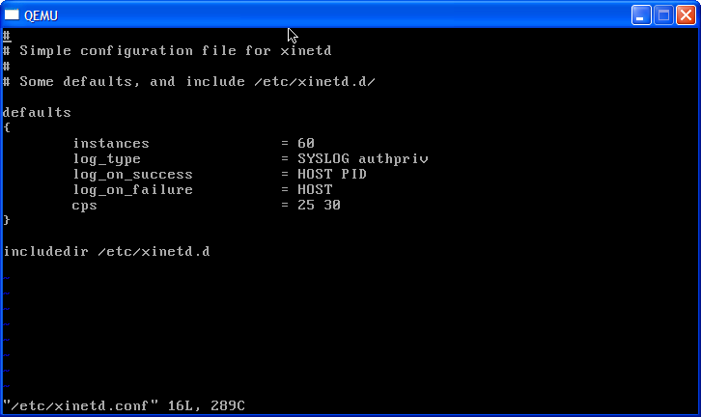
Syntax of xinit.conf file
Notes:
The following specification are possible.
HOST IP dd f : address of client computer
PID : Process identification number of started server process
USERID : User ID of client side user who issued request
EXIT : Record when started server process is ended
DURATION : Time that client connected with service
(5) It sets the output contents to the log when a client fails in the connection to service.
The following specifications are possible.
HOST : IP address of client computer
USERID : User ID of client side user who issued service request
ATTEMPT : Requests to server program that has failed in connection
RECORD : Information on server program that has failed in connection
(6) It sets the maximum number with which the client can be connected per one second to one service.
The following specifications are possible.
cps= [Maximum number connection per a second] [Stop service period (second)]
If the number of connections per second to one service exceeded the number specified by [maximum number
the connection per second] , the ‘xinetd’ daemon temporarily stops the service. And, restart service after
taking the interval specified by [stop service period (second)].
In the example of the setting in the above figure, the service stops provisionally when the number of
connections per second to one service exceeds ’25’. Then, the service restarts in ’30’ seconds.
This can be a good defense counter measure against the DoS (service refusal) attack.
The DoS attack, one of the attack techniques of the server, is a malignant attack. By sending continuously a
large amount of service request to specific service on the server, to waste the resource of the server to
decrease the server's performance, or shut down the system itself.
(7) It specifies the directory that stores configuration file at each service started by the ‘xinetd’ daemon.

Slide 11
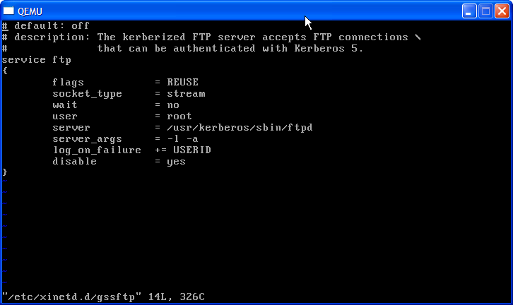
Service definition
Notes:
Files under the control of ‘/etc/xinetd.d’ directory is a file for the advanced settings of each service started from the
‘xinetd’ daemon.The example of the above figure shows contents of the ‘/etc/xinetd.d/telnet’ file of default.
Important:
In order to edit each configuration file under the control of the ‘/etc/xinetd.conf’ file and the ‘/etc/xinetd.d’
directory and and to reflect the changes in the system, it is necessary to restart the ‘xinetd’ daemon.
Restart of the ‘xinetd’ daemon
Below is the format of configuration file.
# /etc/init.d/xinetd restart
Format of configuration file
service service name
{
attribute = | + = | - = value
…
}
* Service name ......... Specify the service names such as ‘telnet’ and ‘ftp’.
The service name to specify must be one that has been registered in the ‘/etc/services’ file.

Slide 12
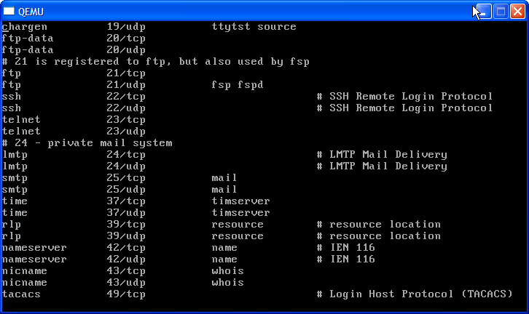
Well-Known services
Notes:
The /etc/services file is a file that defines the service name, the port number, and the protocol name, etc. that are offered on the network. This file is automatically set at the installation. Format of the ‘services’ file:
Service_name Port_number/Protocol_name [Alias of service...]

Slide 13
Add/Remove automatic start of service at system startup
Display automatic start information of service at system startup at different runlevels
# chkconfig --list sendmail
sendmail 0:off 1:on 2:on 3:on 4:on 5:on 6:on
Add service automatic start at system startup
# chkconfig --add sendmail
Remove service automatic start at system startup
# chkconfig --del sendmail
Enable/disable service automatic start at system startup at specific runlevel
# chkconfig --level 3 sendmail on
# chkconfig --level 2 sendmail off
Notes:
You can add/remove automatic start of any service at system startup at a specific run level by manually adding or deleting symbolic link which is a sub file of ‘etc/rc[runlevel].d’
Linux has the ‘chkconfig’ command that create and delete a symbolic link under the ‘/etc/rc [runlevel].d’ directory and that set the automatic start of the service.
Format of the chkconfig command
• chkconfig -- list [service name]
Display at which runlevel the specified serve will start automatically, and at which runlevel it will not start automatically.
Display all services when you omit the service name.
• chkconfig -- add service name
Set for the specified service to be started automatically.
The set runlevel is specified by the description of the service control script.
• chkconfig -- del service name
Set for the specified service not to be started automatically.
The specified runlevel is specified by the description in the service control script.
• chkconfig [--level runlevel] service name on | off
Based on the specified runlevel, you can set service to be started (on) or not to be started (off) automatically.

